Slide 1
Own Your Inbox
Maj Matt Miller
301FW/FM
June 2022

Slide 2
Scenario
You receive an email from AFRC/FMAR regarding an FY22 voucher for a FSS traveler with a particular read on a JTR question.
Where should this email go?
AFRC folder
FY22 folder
FSS folder
FMAR folder
JTR folder
Customer service folder
Lots of decisions…in an already busy world
Once you select a folder, how do you remember where you put it 6 months later? A year? Two years?
What if Outlook could make all these decisions for you?
Notes:
Lumpkin

Slide 3
Agenda
Understand the theory
Create new workflow
How to transition from your current system
Setup & manage rules
Tips & tricks
Resources
Notes:
Lumpkin

Slide 4
Understand the Theory
Goal → “Inbox Zero”
4 D’s - GTD Workflow
Delete It
Do it (respond or file for reference)
Delegate it (forward)
Defer it (Don’t let this become your default!)
Where do I file an important email that covers multiple unrelated subjects?
Everything goes in a single folder
Categories (aka Tags or Labels) create the structure
How is this different than my current foldering system?
Saved Search folders and Rules do all the ‘heavy lifting’
Limit the # of decisions – Free up your mind
Dramatically increase the # of ways emails can be found (4-5x faster)
Notes:
Lumpkin

Slide 5
Create New Workflow
Goal → Limit the # of Categories…trust the system, it works!
How? → Everything goes in Archived folder
Use Categories to create ‘Saved Search’ folders (aka Smart Folders)
Right click ‘Search Folders’ to create
How To Guide
Breakdown work into major Categories
Good: FMA, FMF, AFRC, Personal, Regulations, Systems, Training, FY2X
Broad yet specific; limit overlap; enable quick decisions
Bad: Bob Jones, CivPay Regulations, CMS Metrics Meetings
Too specific; creates indecisiveness & uncertainty; quickly becomes unmanageable
Do NOT stress about color coding; NOT the point of this system
Notes:
Lumpkin

Slide 6
How To Transition
Goal → Transition to new system in less than 1 hour
Do your best to map your current workflow (lots of folders) to your new, more streamlined process (major Categories)
1) Select All (Ctrl+A) emails in old folder
2) Apply new Category to all emails
3) Drag all emails in old folder to your Archived folder
4) Delete old folder
Repeat process until done
Step 1
Step 4
Step 2
Step 3
Notes:
Lumpkin

Slide 7
Setup & Manage Rules in Outlook
Goal → Automate your inbox
Create rules to automatically Categorize emails as they come in
Not mandatory, but I recommend setting up rules in OWA versus Desktop Outlook
More easily migrates with you and is easier to manage
Home > Rules (dropdown) > Create Rule… > Advanced Options…
Answer a Series of Questions
Which condition(s) do you want to check? (i.e. from someone(s), key words, certain subject lines)
What do you want to do with the message? (i.e. Assign Category, delete, mark as read, forward)
Are there any exceptions? (Typically, I skip this step and just click Next)
Specify a name for this rule – Be specific; make it something you’ll easily recognize
What if my Rules change overtime?
Super easy to edit/delete
File > Manage Rules & Alerts > E-mail Rules Tab > Select Rule > Change Rule or Delete
Notes:
Lumpkin

Slide 8
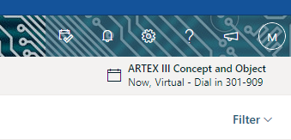
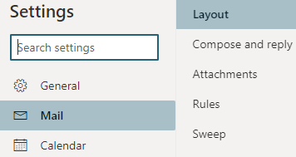
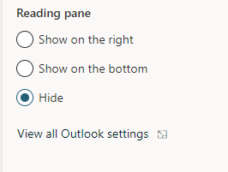
Setup & Manage Rules in OWA
Recently transitioned Rules from Desktop Outlook to OWA
Step 1
Step 3
Step 2
From here, all steps follow the same process as described on the previous slide
Using OWA ensures your rules follow you from computer-to-computer and will also apply all rules to Desktop Outlook
Reduces duplication of effort as you move or change computers
Notes:
Lumpkin

Slide 9
Tips & Tricks
Leverage Quick Access Toolbar (QAT) (How to Guide)
Customize QAT in both the main Outlook screen & individual email screen
Right-click any button in toolbar and select ‘Add to Quick Access Toolbar’
Move icons to far left of QAT to create easy-to-remember Hot Keys
Alt+1 = Move to folder (typically general)
Alt+2 = Categorize
Prioritize emails sent directly to you in a different color (How to Guide)
Presumably you need to take action; these are ‘must-read’ messages
Notes:
Lumpkin

Slide 10
Color Code Your Inbox
Use Conditional Formatting to highlight certain emails
Example → Emails sent directly to me turn Green and bold
Select View > View Settings > Follow screenshots below
Step 1
Step 2
Step 3
Notes:
Lumpkin

Slide 11
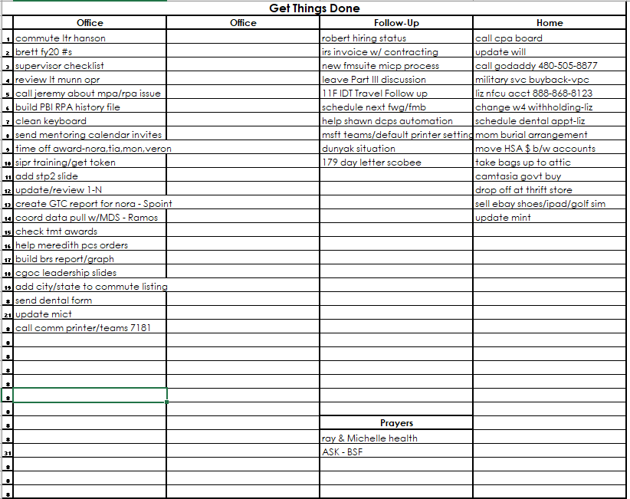
Other Productivity Hacks
Get familiar with OneNote (https://youtu.be/6E3eC2HfQJ0)
Incredible OCR (Optical Character Recognition)
21st Century Continuity Book
Finance OneNote Example
Listen to audio on 1.5+ speed
Build up your listening skills to a goal speed…don’t just start there!
YouTube, Podcasts, Audiobooks
Read Getting Things Done: The Art of Stress-Free Productivity –David Allen
Get everything out of your head
Makes writing evals/awards super easy
Becomes a defacto life journal
Email me if you’d like my template
william.miller.126@us.af.mil
Use a password manager
2 Factor Authentication
Great for families
Notes:
Lumpkin

Slide 12
Resources
Theory & Ideas Behind System
Microsoft Outlook Best Practices
The Only 5 Folders Your Inbox Will Ever Need-Fast Company
6 Best Practices-Outlook Boost Workflow
David Allen’s Official GTD Outlook Guide
How to Setup Rules Guide
Automatically Change Colors on Emails Sent Only to You
Use Outlook Rules to Auto-Categorize Incoming E-mail
How to Setup Categories Guide
Microsoft's Categories Guide
What Is Text Expansion & How Can It Help You Save Time?
Snooze an email in Outlook
Change the subject line on an email you received
Notes:
Lumpkin

