Slide 1
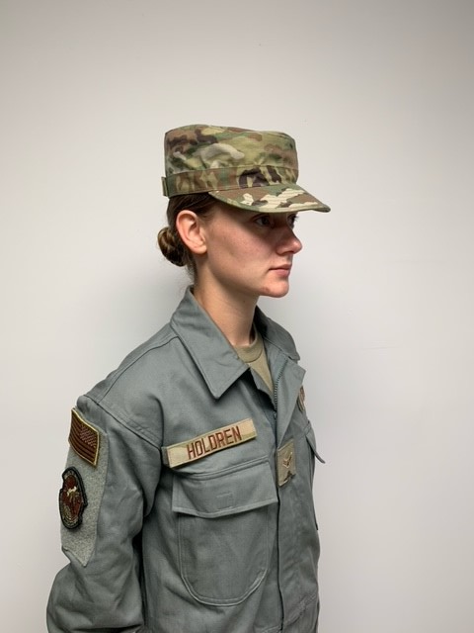
Department of the Air Force
I n t e g r i t y - S e r v i c e - E x c e l l e n c e
Air Force Authorized Coverall Uniform for use on and off installations!
16 Jan 2022
1

Slide 2
Bottom Line Up Front
Approved!!! The Maintenance Duty Uniform (MDU) is authorized for wear when transiting from home to duty location, off base short convenience stops, eating at restaurants where people wear comparable civilian attire and all locations on installations
MDU approved in DAFI36-2903 7 FEBRUARY 2020 page 145
A7.7.20. Maintenance Duty Uniform (MDU). Commanders of Airmen in these AFSCs, 2A, 2F, 2G, 2M, 2P, 2S, 2T, 2W, 3E, 3D, and 1P may authorize Airmen to wear the sage MDU. The sage color MDU will be unit funded as organizational clothing and equipment. MDU will be worn with nametape, service tape and rank along with the higher headquarters patch on the left sleeve and a subdued U.S. flag and organizational patch on the right sleeve

Slide 3
Maintenance Duty Uniform
Approved!!!! proposed Coverall Uniform for Aircraft Maintenance, Industrial, all other Laborer intensive AFSCs.
Unit Funded- NSN’s. 8405-01-534-7457 (X-Small), 8405-01-534-7465 (Small), 8405-01-534-7470 (Medium), 8405-01-534-7482 (Large), 8405-01-534-7488 (X-Large), 8405-01-534-7496 (XX-Large)
Note: Duty identifiers, as applicable may be worn on the left sleeve. The coyote brown t-shirt, OCP patrol or tactical cap, coyote brown or green socks, and coyote brown boots, are worn with the uniform. The MDU will not be utilized for office work environments, non-industrial or non-labor tasking
It must be worn in serviceable condition. Do not wear off base to eat in restaurants where most diners wear business attire or at establishments that operate primarily to serve alcohol. Local coverall variants are still authorized but only in work centers and on the flight line

Slide 4
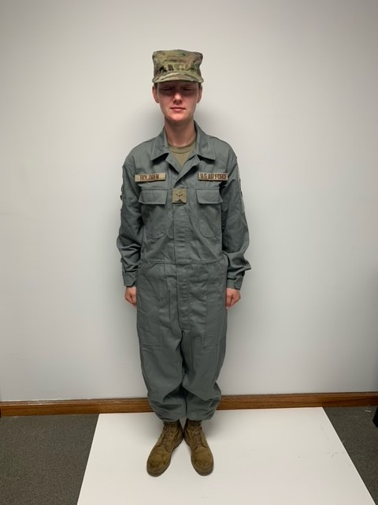
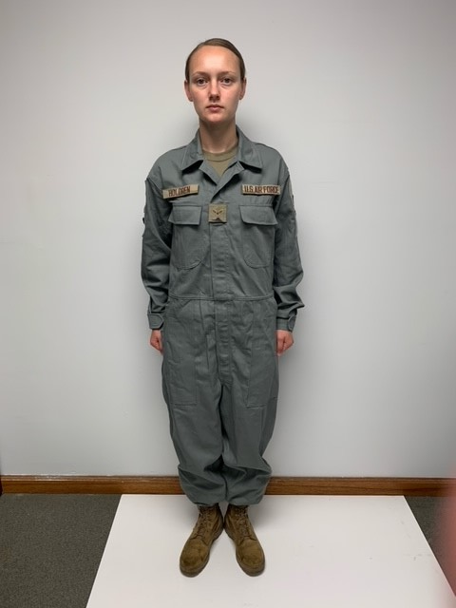
AF- MDU
APPROVED!

Slide 5
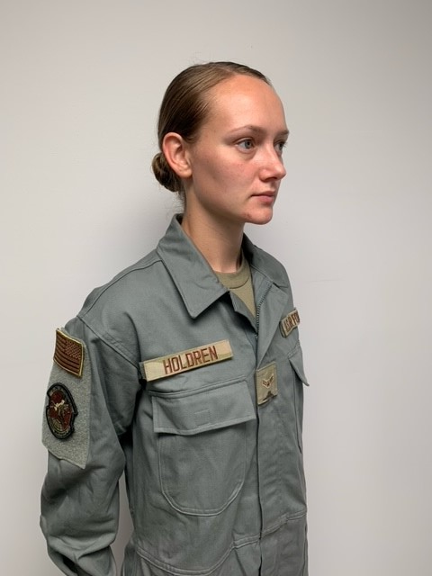
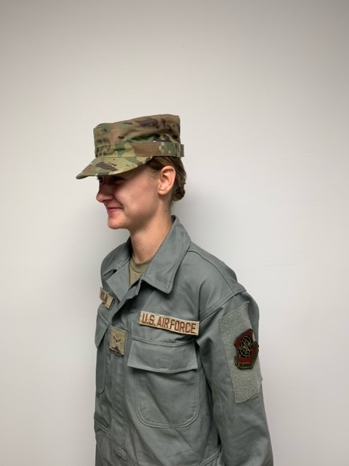
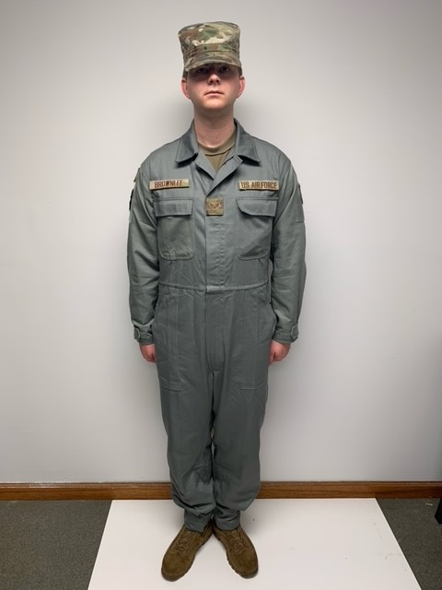
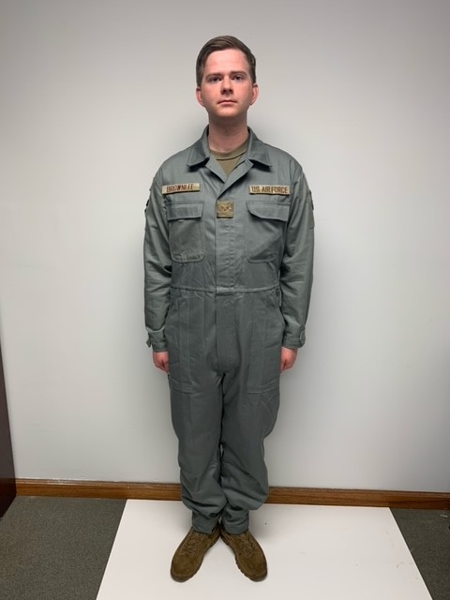
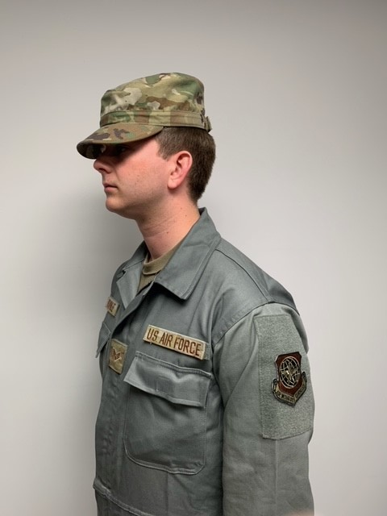
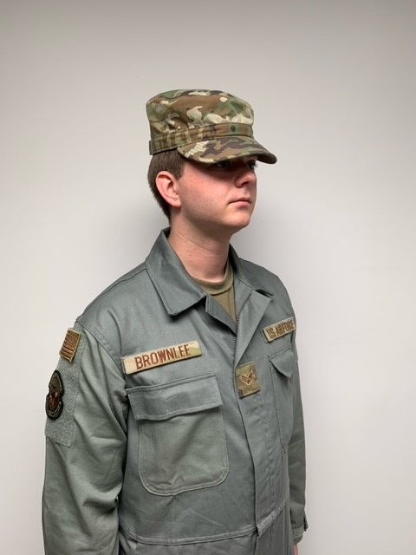
AF - MDU

Slide 6
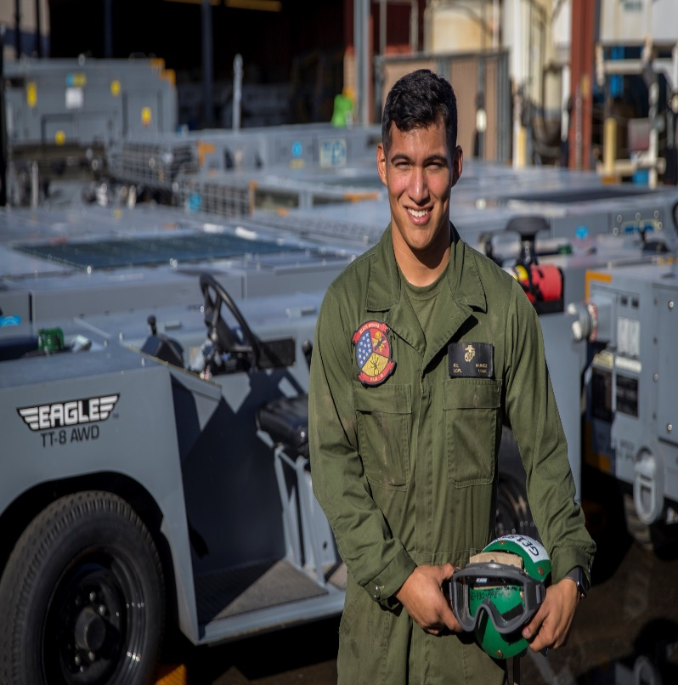
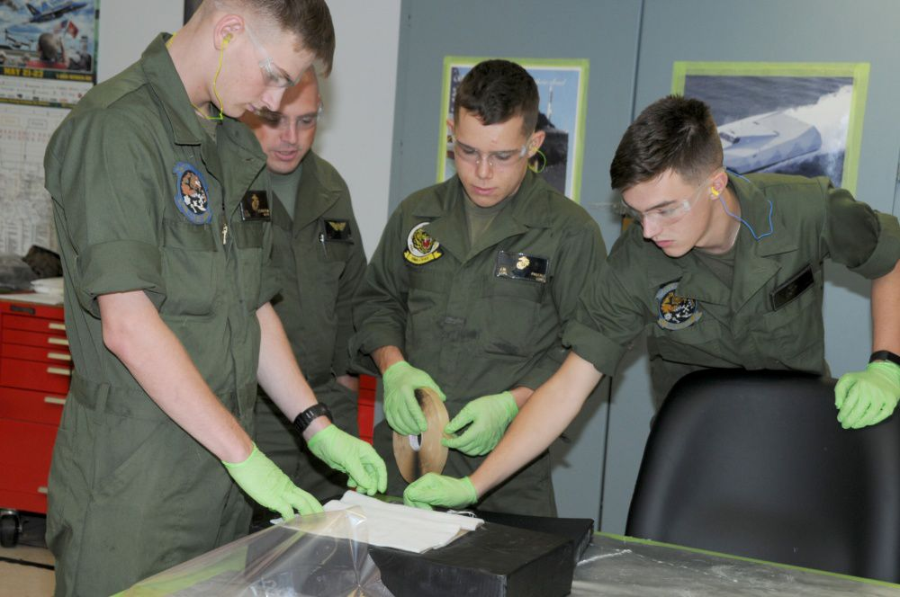
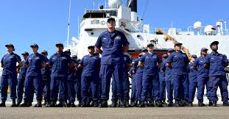
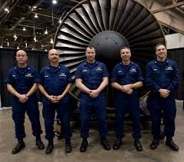
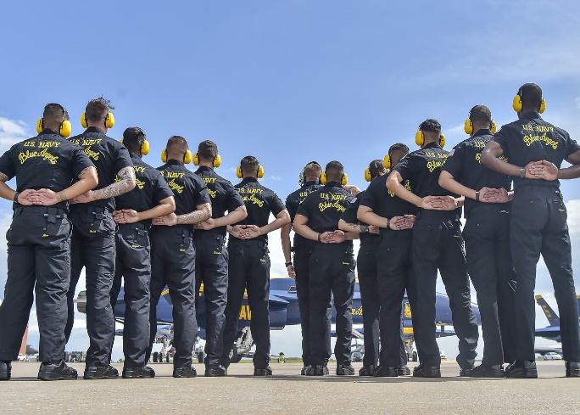
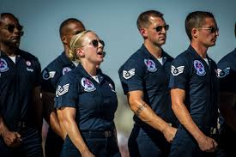
Other Services MDU

